Slide 1
Borrowings from Arabic into Domari
What happens when a concatenative language borrows from a templatic one?
Romany “Finn” Amber & Seth “Dani” Katenkamp
Yale University
International Conference on Romani Linguistics, 25/09/2025
Notes:
Both :)

Slide 2
Introduction

Slide 3
A borrowing from Arabic
(1) (a) Domari form: ftuḥ-k ‘conquer’
(b) Arabic root: ftḥ ‘open, conquer’
But no inflected form of the Arabic root /ftḥ/ looks like ftuḥ.
(2) Palestinian Arabic:
(a) fataḥ ‘opened’
(b) ftaḥ ‘opens’
So where does the Domari form come from?
Notes:
[F]

Slide 4
Central claims
In this talk we argue that:
(3) (a) Domari borrows abstract, tri-consonantal roots from Arabic, despite the
fact that those roots never occur in isolation in surface forms.
(b) For some of those roots, the phonological material was/is mapped to
phonological templates, but unlike Arabic templates, these have no
semantic meaning.
Notes:
[F]

Slide 5
Roadmap
2. Language background
3. Possibilities
4. Methodology
5. Results
6. Conclusion
Notes:
[F]

Slide 6
2. Language background

Slide 7
Domari - background
Indo-Aryan language (~ related to Romani) spoken in the Middle East.
280,000 speakers (though estimates differ wildly)
Originally nomadic community. Stigmatised.
Our variety is from Jerusalem - 10 speakers. Documented by Matras in 2012
Very high bilingualism - code-switching as a “rule”
Notes:
[F] - bring in epenthesis - not the thing about word-initial epenthesis: breaking up C1C2C3 vs C1C2C2

Slide 8
Domari and Arabic phonotactics
Arabic does not allow word-initial consonant clusters – epenthetic /ʔi/ word-initially if previous word ends in a vowel or /i/ if it ends in a consonant (Ryder, 2005)
Domari also seems to disprefer word-initial clusters. But epenthetic /i/ only added if previous word ends with a consonant.
(4) (a) naːmɔs ɪkleːb ‘his name was Kleb’
(b) bɪsaːtɨneːsmma kleːb ‘Kleb’s gardens’
OR if morphophonology creates a sonority-violating CCC cluster:
(5) (a) /kn/ + /ami/ -> (i)knami ‘sell’ (b) kn/ + /dom/ -> /kɨndom/ ‘sold’
Notes:
[F]

Slide 9
3. Possibilities
What are the possible strategies to borrow from a templatic language?

Slide 10
Arabic templatic morphology
Arabic roots (mostly) sequences of three consonants, e.g. ftḥ
Surface forms derived by mapping consonants to a template
As described by McCarthy (1979):
Root: dictate most of the meaning. Consonants
Template: information about tense, causality, word type - how root should be interpreted. Vowels.
While ftḥ is a common root, there are no surface forms with the string /ftḥ/
They all contain additional vowels
_a_a_ = [PAST]
fataḥ = ‘opened’
(6)
f_t_ḥ = OPEN
Notes:
[D]

Slide 11
So you want to borrow a verb from Arabic?
Here are (some of) the options:
Borrow a noun (*fatḥ + aux, ‘do (a) conquering (act)’)
Borrow the root, vowel epenthesis (ftuḥ)
Borrow the root, use with a template (*fattiḥ)
Borrow a one surface stem (e.g. *fataḥ ‘opened’ or *ftaḥ ‘open’)
Notes:
[F] “Think about the logical options”

Slide 12
So you want to borrow a verb from Arabic?
1. Borrow a noun:
Lots of verb stems derived from one root, but only one noun (running/ran/runs vs (a) run)
Most common strategy cross-linguistically:
Urdu: tabādla karna ‘to transfer’ (lit. ‘to make exchange’)
Disadvantages:
Borrowing something with a slightly different meaning.
Diagnostic: The Domari matches the Arabic noun form, but none of the active verbal stems.
Notes:
[F/D]

Slide 13
So you want to borrow a verb from Arabic?
1. Borrow a noun
2. Borrow the root and epenthesise
Epenthesis = adding sounds to make it pronounceable, Usually /i/ or /ə/
Eg. /ftḥ/ -> *[fth], [ftuḥ]
Disadvantages
Same as previousː speaker(s) need to have worked out the Arabic root first.
Diagnostic: The Domari root is shaped CCC plus an appropriate epenthetic vowel.
Notes:
[F/D] note all people using this language to communicate must have this knowledge from somewhere.

Slide 14
So you want to borrow a verb from Arabic?
1. Borrow a noun
2. Borrow the root and epenthesise
3. Borrow the root and add your own template
Make a rule like “Domari verbs are Arabic verbs with an /a/ and an /e/”
So /ftḥ/ -> [fateḥ], /fkr/ (“think”) -> [faker]
Disadvantages
Probably the most complex - you need to know how roots and templates workǃ
Domari’s source (Indo-Aryan) doesn’t have themː adding something big to language
Diagnostic: A (stereo-)template is proposed when there are several Domari verbs with the same shape, and some of them
(a) cannot be a CCC root plus epenthesis and
(b) have no match in the Arabic verbal forms.
Notes:
[F/D] note all people using this language to communicate must have this knowledge from somewhere.

Slide 15
So you want to borrow a verb from Arabic?
1. Borrow a noun
2. Borrow the root and epenthesise
3. Borrow the root and add your own template
4. Borrow a verb
Choose from the options that surface in Arabic
For [ftḥ] “open/conquer”, borrow either fataḥ “opened” or ftaḥ “opening”
Disadvantages:
How to decide which one?
Diagnostic: The Domari matches Arabic verbal form(s) and cannot be explained by epenthesis or one of the stereo-templates.
Notes:
[F/D]

Slide 16
4. Methodology

Slide 17
Source of data
Matras (2012) has a dictionary with ~1000 entries.
~250 are verbs, ~50% of which are Arabic borrowings
cf. ~60% of English vocab is Latinate (inc. French); just over 50% Japanese vocab is Sinitic
We compared these forms to the stem forms that exist in Modern Standard Arabic and Palestinian Arabic
Total of 92 verbs investigated
Notes:
[F] Some we weren’t able to find an Arabic for, some were different Domari entries that were v similar in Arabic etc.

Slide 18
Varied correspondences (with Palestinian Arabic)
(7)
gloss | Domari | noun | past | present
‘leave’ | rawwaḥ-k/-ahr | * | rawwaḥ | rawwiḥ
‘stop’ | baṭṭil-ahr | bṭīl | baṭṭal | baṭṭil
‘kiss’ | bawus-k | baws | bus | būs
‘conquer’ | ftuḥ-k | fatḥ | fataḥ | ftaḥ
Notes:
[D]

Slide 19
5. Results
What strategies does Domari use?

Slide 20
Strategy 1 - Borrow a noun (7/92 examples- 8%)
Domari bawus-k “kiss” and the Arabic noun: baws (a) kiss”
(8)
gloss | Domari | Arabic noun | Palestinian past | Palestinian present
‘kiss’ | bawus-k | baws | bus/bās | būs
Notes:
[D]

Slide 21
Strategy 2 - Root + Epenthesis (42/92 examples- 46%)
Borrow the root with /i/ and/or /u/ inserted to make it pronounceable
(10) Conditioning of /i/ vs. /u/:
(a) /i/ before b, d, f, k, m, n, s
(b) /u/ before b, ḍ, ḥ, l, n, q, r
(9)
Triliteral root | Domari Form | Meaning | Domari Shape
ṣrf | srif | spend | CCiC
ḥbb | ḥibb | like | CiCC
zhr | zhur | appear | CCuC
Notes:
[D]

Slide 22
Strategy 3- Domari-specific template(s) (33/92 ex.- 36%)
Template | Verbs without surface match | Total verbs | Example
CaCCiC | 7 | 16 | naddim- k “regret” from √NDM
CaCaC | 2 | 6 | walaʕ-k ‘light’ from √WLʕ
CaCiC | 2 | 4 | ḥawil-k “try” from √ḤWL
CaCC(i) | 1* | 7 | rabbi-k “raise” from √RBB
(11)
*3 with no match in MSA, 3 with no match in Palestinian (but not the same 3)
Notes:
[D] Palestinian ndim or ndam

Slide 23
Strategy 4 - Borrow a surface form (5/92 examples- 5%)
fḍaḥ-k “scandalise”; same as Palestinian present fḍaḥ
rawwaḥ “leave”; same as Palestinian past rawwaḥ
farraḥ-k-ar “rejoice”; same as ‘Standard’ Arabic passive/participle
Doesn’t match any Palestinian Arabic forms.
Maybe tells us something about the timeline of borrowing (before reaching Palestine?)
Notes:
[D]

Slide 24
What’s left? (5/92 examples- 5%)
Things we aren’t sure aboutǃ
(12)
Several possibilitiesː
Borrowed from a different variety?
Semantic change (inc. changes specific to templatic languages)?
Random noise?
Notes:
[D]

Slide 25
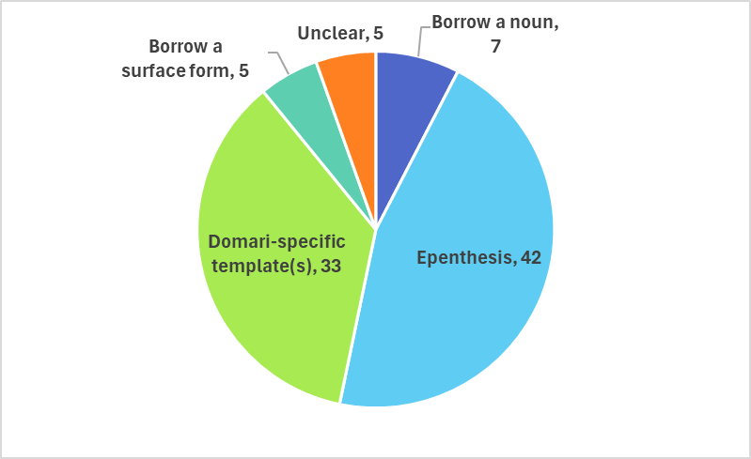
The distribution across 92 borrowings from Arabic
(13)
Notes:
[D]

Slide 26
6. Conclusion
What strategies does Domari use?

Slide 27
Summary
(14)
Strategy | In Domari verbs? | Cross-linguistically?
Borrow a noun | Yes, rare | Common
Borrow a verb | Yes, rare | Common
Borrow the root | Yes, common | Rare
Borrow the root and add your own template | Yes, common | Very rare
Notes:
[F]

Slide 28
Conclusion
Domari uses several strategies when borrowing words from Arabic
But the forms of most (82%) borrowed verbs can be explained as borrowing of abstract triliteral roots (and sometimes a loanword template that is a Domari innovation)
Speakers are able to ‘work out’ Arabic roots even though they have never heard them in isolation!
Why can Domari borrow invisible things? We think this is related to unique and high-contact bilingualism in nomadic communities.
What factors underlie the strategy chosen? Can we deduce anything about migration or sociology?
Notes:
[F]

Slide 29
Implications for linguistic theory
Is this compatible with paradigmatic models of morphology? If so, what are speakers intuiting about Arabic?
Predictions: If this is still an active part of the grammar, we would expect them to apply the templates to new, made-up ‘borrowings’?
(15) Hypotheses for synchronic derivation
(a) template as a loanword marker: (b) template only at actuation:
ḥawilk ḥawilk
ḥwl -CaCiC -k ḥawil -k
try -loan -voice try -voice
Other languages, e.g. Swahili
Notes:
[F]

Slide 30
(16) Swahili borrowings from Arabic
gloss Swahili Arabic stem Arabic noun Arabic root
(i) ‘despise’ -hakiri ḥaqar(a) ḥaqr HQR
(ii) ‘flourish’ -shamiri šammar(a) (ta)šmīr SMR
(iii) ‘participate’ -shiriki šārak(a) (mu)šāraka SRK
(iv) ‘surpass’ -kithiri kaṯur(a) kaṯra KṬR
Notes:
[D]

Slide 31
Acknowledgements
Thank you to:
Yaron Matras, for compiling the data we use here and writing the grammar.
Lameen Saug, for his expert advice on Arabic grammar and dialectology.
Natalie Weber and Jason Shaw, for their feedback on this project (and especially on this presentation).
Notes:
[F]

Slide 32
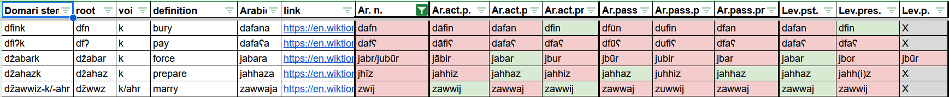
Appendix A - coding for different stems (in different dialects)
(17)

Slide 33
Appendix B - Reducing the number of proposed templates
CaCC and CaCiC could be the same template, occur in complementary distribution:
The Domari verbs with CaCC shape have a geminate, i.e. the last two consonants match
The Domari verbs with CaCiC shape have different consonants
rabbi-k and ḥawil-k vs. *rabibk and *ḥawlik
The /i/ in CaCiC is epenthetic, breaks up heterorganic clusters
(18) ḥwl + k (input)
ḥawl + k (CaCC template)
ḥawil + k (epenthesis because */wlk/)

